Slide 1


Faculty of Computing and Informatics
Business Management Information Systems – BMC511S
Lesson 1 – An introduction to information systems in organizations

Slide 2
Faculty of Computing and Informatics
Introduction to information systems (IS) in organisations
An introduction to information systems
Components of information systems
Functions of an information system
Different types of information systems
Strategic business objectives of information systems
Business functions of information systems
Organisational dimensions of information systems
Management dimensions of information systems
Technology dimensions of information systems

Slide 3
How Information Systems Are Transforming Business
Global spending on information technology (IT) and IT services: nearly $3.8 trillion in 2019; $160 billion spent on management consulting and services
Organizational, management, and cultural changes are often required for firms to derive full business value from IT investments

Slide 4
In a fully digital firm:
  Significant business relationships are digitally enabled and mediated
  Core business processes are accomplished through digital networks
  Key corporate assets are managed digitally
Digital firms offer greater flexibility in organization and management
  Time shifting, space shifting

Slide 5
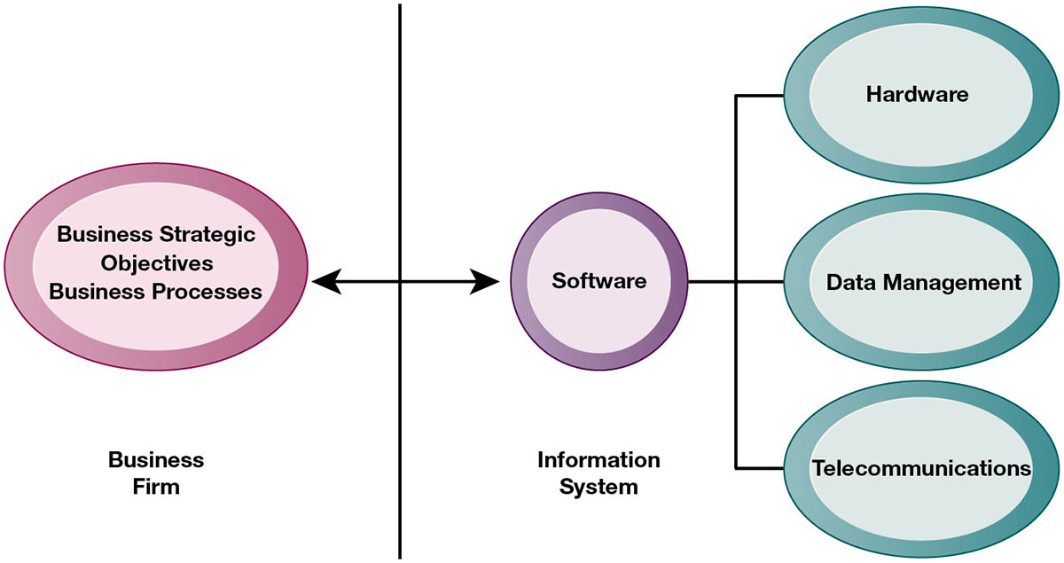
Growing interdependence between:
  Ability to use information technology
  Ability to implement corporate strategies and achieve corporate goals

Slide 6
Faculty of Computing and Informatics
An introduction to information systems
- An information system (IS) is any organized network of people, organisations, and infrastructure for the collection, organisation, storage and communication of information
- An information system (IS) is a combination of hardware, software, infrastructure and people organized to facilitate planning, control, coordination and decision-making in an organisation.
- An information system is a collection of technical and human resources that provide storage, computing, distribution and communication of information required by all or some part of an enterprise

Slide 7
Activities in an information system that produce information:
  Input
  Processing
  Output
  Feedback
Sharp distinction between computer or computer program versus information system

Slide 8
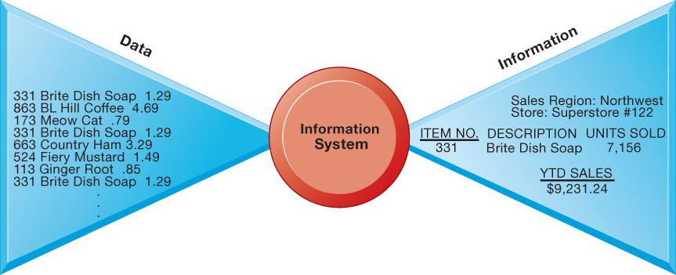
Faculty of Computing and Informatics
An introduction to information systems
- Data are basic values or facts
- Information is data that has been processed to provide answers to questions
An information system turns raw data into useful information that can be used for decision-making.

Slide 9
Faculty of Computing and Informatics
Components of an information system
- Hardware – the physical artefacts e.g. cellphone, computer
- Software – programs to organize, process and analyse data
Databases – data organized into tables and files
Network – different elements connected to each other
Procedures/processes – how data is processed and analysed to get answers
People – the users
Systems need to be designed to fit the firms and the humans who work with the systems.

Slide 10
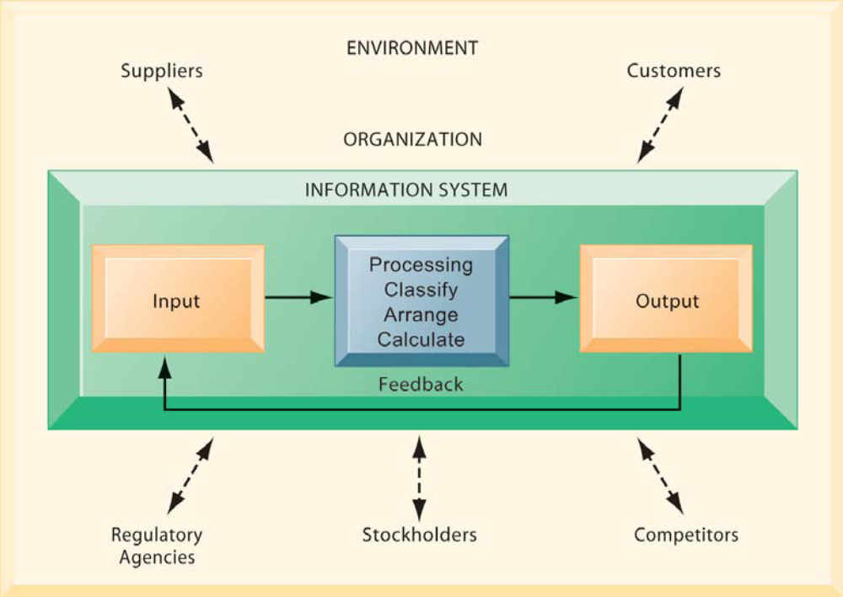
Faculty of Computing and Informatics
Functions of an information system
- Input, process, output – produce the information organisations need
Feedback – output returned to appropriate people/activities in the organisation to evaluate and refine input
Environmental actors – customers, suppliers, competitors, regulatory agencies
Environmental actors – customers, suppliers, competitors, regulatory agencies

Slide 11
Faculty of Computing and Informatics
Different types of information systems
Executives
Executive information systems
Senior managers
Decision support systems
Middle managers
Management information systems
Workers
Transaction processing systems

Slide 12
Faculty of Computing and Informatics
Different types of information systems
Executive information systems (EIS) also known as Executive Support (ES) is a type of information system that facilitates and supports senior executive information and decision-making needs
Decision support systems (DSS) is a software-based interactive system intended to help decision-makers compile useful information from a combination of raw data, documents and personal knowledge or business models to identify and solve problems
Management information system – a computer-based system that provides managers with tools to organize, evaluate and efficiently manage departments within an organisations
A transaction processing system is an information processing system for business transactions involving the collection, modification and retrieval of all transaction data

Slide 13
Faculty of Computing and Informatics
Business functions of information systems
Sales and marketing – selling the organisation’s products and services
Manufacturing and production – producing and delivering products and services
Finance and accounting – managing the organisation’s financial assets and maintaining the organisation’s financial records
Human resources – attracting, developing and maintaining the organisation’s labour force, maintaining employee records

Slide 14
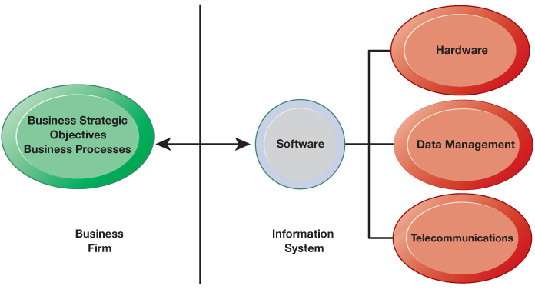
Faculty of Computing and Informatics
Interdependence between organisations and information systems
Business and strategic objectives feed into the information system

Slide 15
Faculty of Computing and Informatics
Strategic business objectives of information systems
Businesses continuously seek to improve the efficiency of their operations in order to improve profitability
Changes in strategy, rules, and business processes requires a change in hardware, software, databases and telecommunications
The strategic business objectives include:
  New products and services
  New business models – how a company produces, delivers and sells a product or service to create wealth, e.g. music moved from CDs into online
  Customer and supplier intimacy - know your customer, e.g. Wifi in your hotels for the business customer

Slide 16
Faculty of Computing and Informatics
Strategic business objectives of information systems cnt’d
The strategic business objectives include:
  Improved decision-making – the right information made available to make the right decisions e.g. forecasting demand for goods and services
  Competitive advantage – operational excellence, new products, services and business models, supplier intimacy gives a competitive advantage
  Customer and supplier intimacy - know your customer, e.g. Wifi in your hotels for the business customer
  Survival – information systems are necessities of doing business, e.g. ATMs

Slide 17
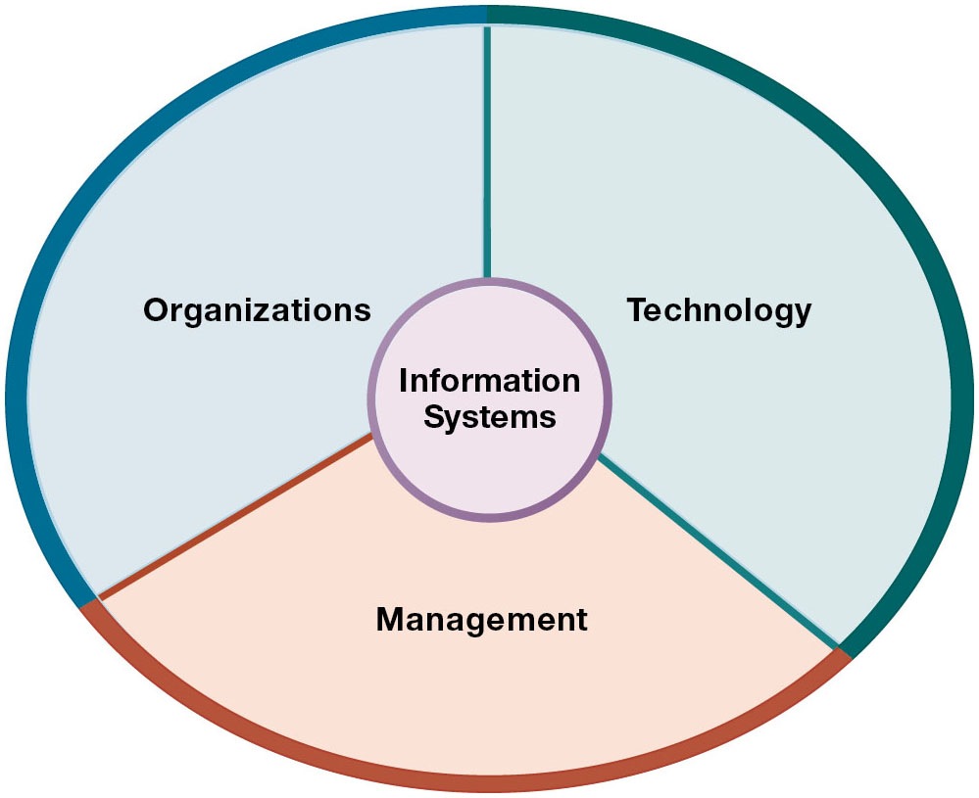
Faculty of Computing and Informatics
Organisational dimensions of information systems
Organisations have structures with a clear cut division of labour
At the upper levels of the structure are managerial, professional and technological staff
At the lower levels are operational personnel
At the management level:
  Senior management – is responsible for long term strategic decisions, products and services and financial performance
  Middle management – carries out the programs and plans of senior management
  Operational management – monitor the daily activities of the business

Slide 18
Faculty of Computing and Informatics
Organisational dimensions of information systems
At the worker level we have two different types of workers:
  Knowledge workers, e.g. engineers, scientists and architects. All design new products and services and create new knowledge for the firm
  Data workers, e.g. secretaries, clerks. They assist with scheduling and communication at all levels of the firm

Slide 19
Faculty of Computing and Informatics
Organisational dimensions of information systems
At the technology level:
Computer hardware – physical components used for input, processing and output activities in an information system, e.g. telecommunications devices, input/output and storage devices
Computer software – instructions that control and coordinate computer hardware components
Data management technology – software governing the organisation of data on physical storage media
Networking and telecommunications technology – physical devices and software, linking hardware and transfer from one physical location to another.

Slide 20
Faculty of Computing and Informatics
Organisational dimensions of information systems
At technology level:
Networks – links two or more computers to share data or resources such as printers and computers
Internet – global ‘network of networks”
Intranet – internal corporate network
Extranets – private intranets extended to authorized uses outside organisations
World wide web – service provided by the internet that linkes web pages

Slide 21
13 Storch Street
Private Bag 13388
Windhoek
NAMIBIA
T: +264 61 207 2258
F: +264 61 207 9258
E: fci@nust.na
W: www.nust.na
Faculty of Computing and Informatics
Thank You.

